Slide 1

Hitchhiker's guide to Benchmark.NET
- Anuroopa Shenoy

Slide 2
Hitchhiker's guide to Benchmark.NET
Introduction
Why Benchmarking?
Why Benchmark.NET?
Benchmark.NET Features
Examples
Demo
Q & A

Slide 3

Marquee Sponsor

Slide 4








Platinum Sponsors
Gold Sponsors
Silver Sponsors

Slide 5
About … (Introductions)
About me
Anuroopa Shenoy
.NET Developer for 12 years
About talk
Prerequisites - .NET

Slide 6
Why Benchmarking?
Performance is important
Server or UI
Analyze new approaches or features
Proof is in the numbers

Slide 7

Why Benchmark.NET?
Why reinvent the wheel?
This Photo is licensed under CC BY-NC-SA

Slide 8
Why Benchmark.NET?
Library with a rich feature set
Supported by .NET Foundation
Used by projects like
CoreCLR
Roslyn
EntityFrameworkCore
F#

Slide 9
Benchmark.NET
https://github.com/dotnet/BenchmarkDotNet
https://benchmarkdotnet.org/articles/overview.html
https://benchmarkdotnet.org/articles/guides/getting-started.html
https://benchmarkdotnet.org/articles/guides/how-it-works.html

Slide 10
Benchmark.NET Features
Reporting system
Parameterization
Memory diagnostics
Benchmarking routine
warmup, iteration
Relative performance

Slide 11
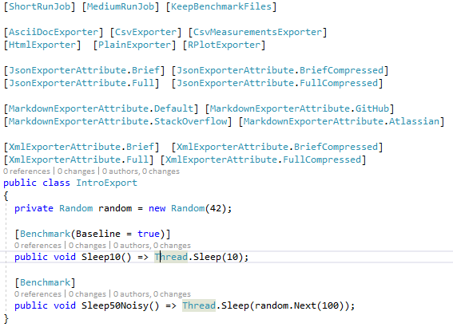
Reporting System

Slide 12
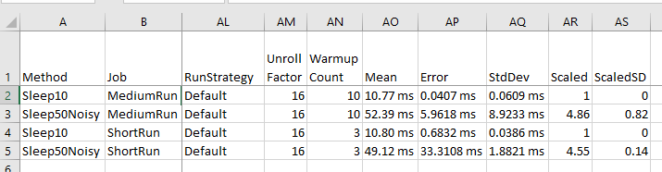
Reporting System - CSV

Slide 13
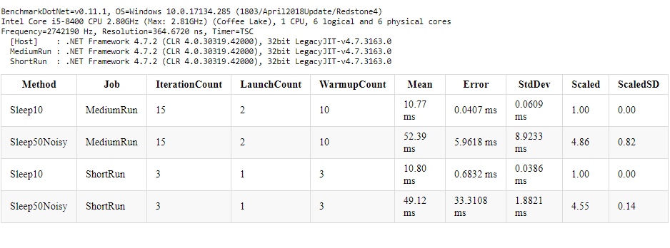
Reporting System - HTML

Slide 14
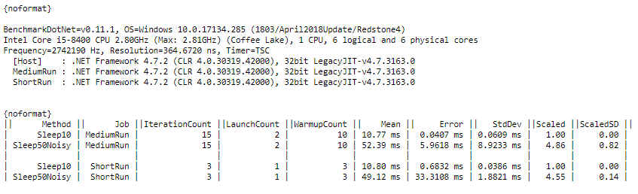
Reporting System - Markdown

Slide 15
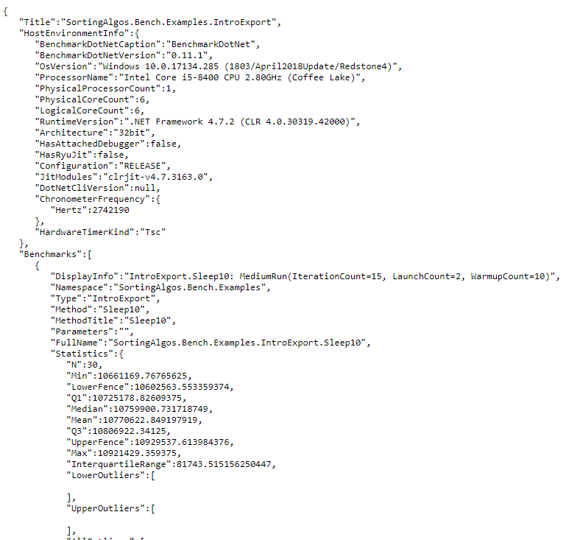
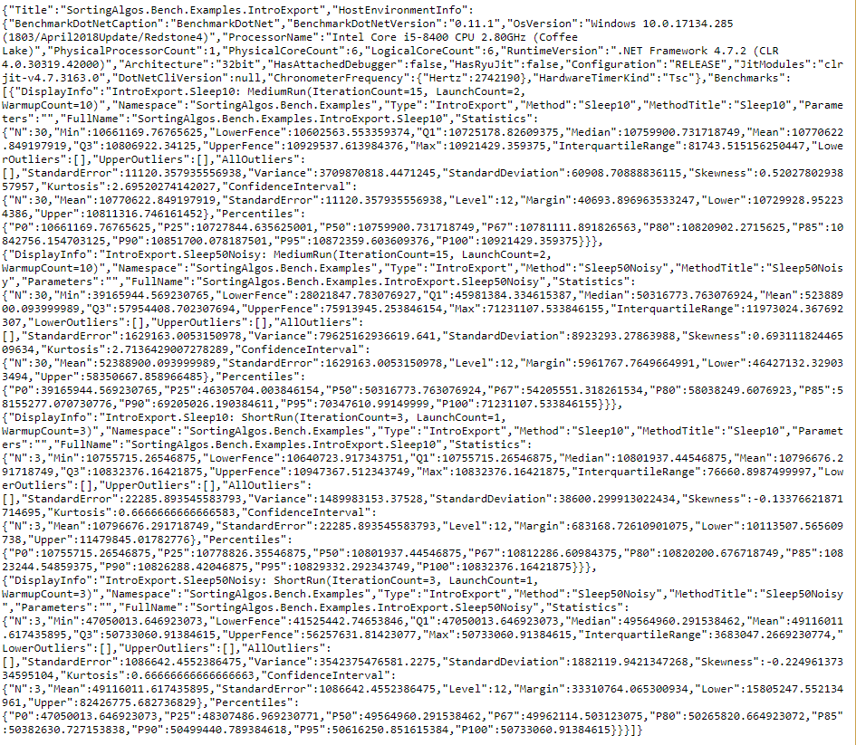
Reporting System - JSON
Compressed

Slide 16
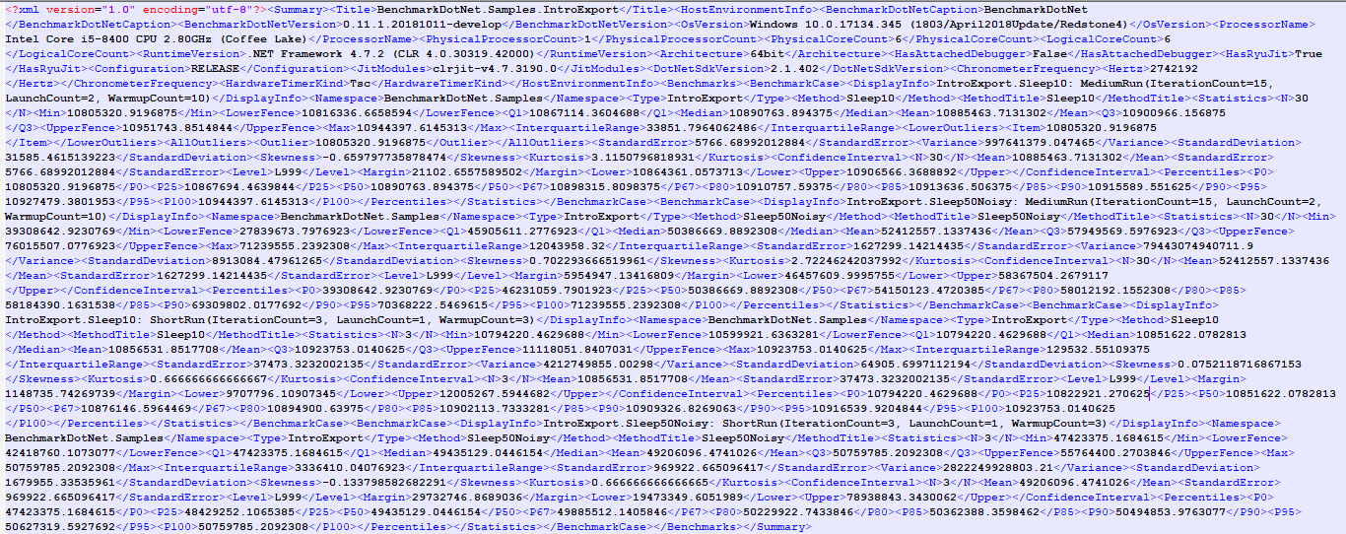
Reporting System - XML

Slide 17
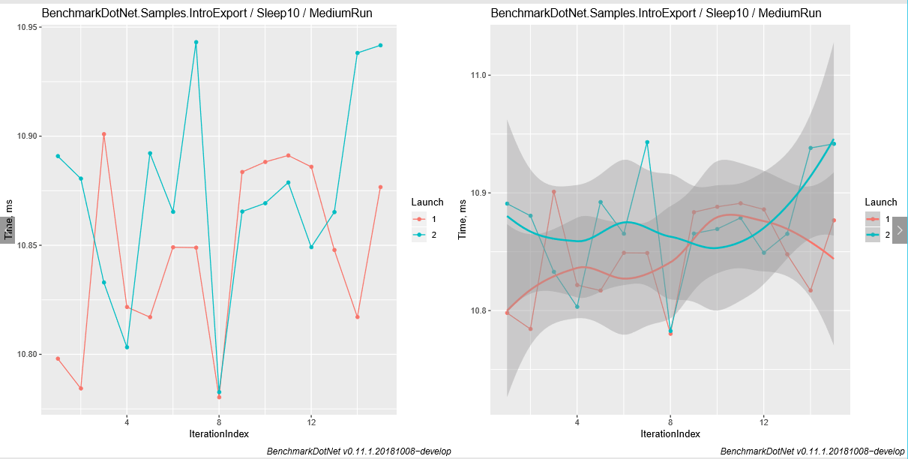
Reporting System – R Plots

Slide 18
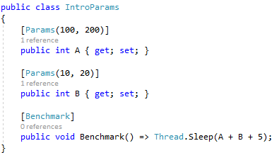
Parameterization

Slide 19
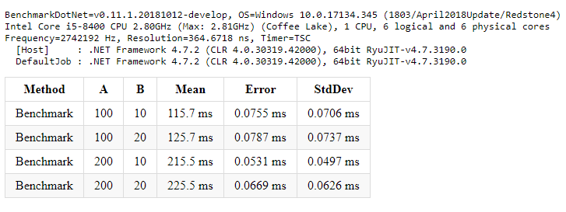
Parameterization - Results

Slide 20
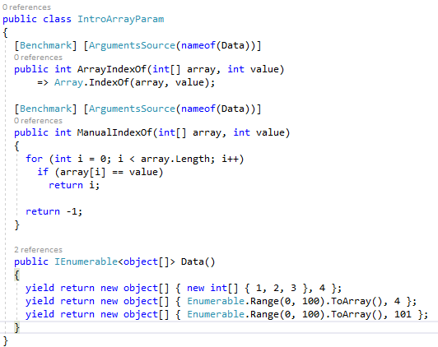
Parameterization

Slide 21
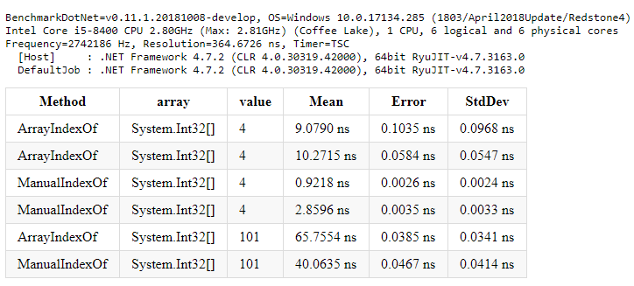
Parameterization - Results

Slide 22
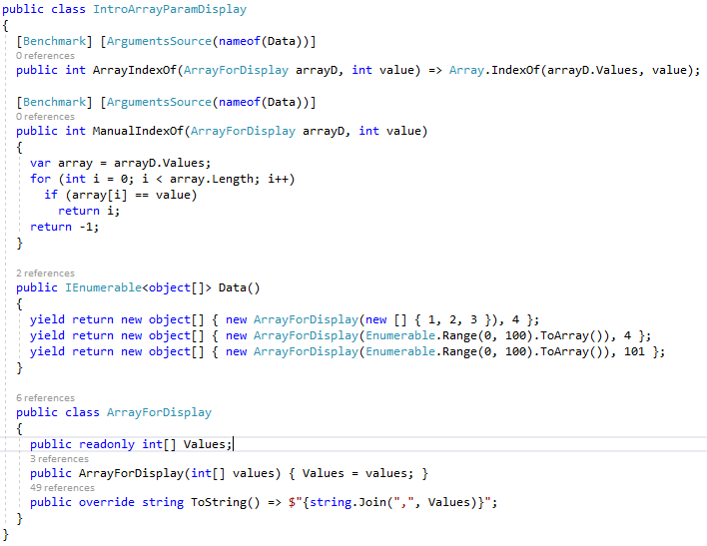
Parameterization – Display customization

Slide 23
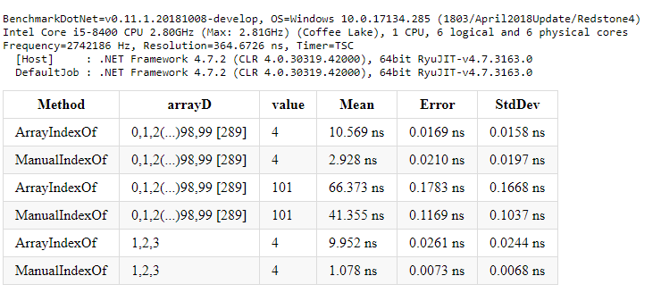
Parameterization

Slide 24
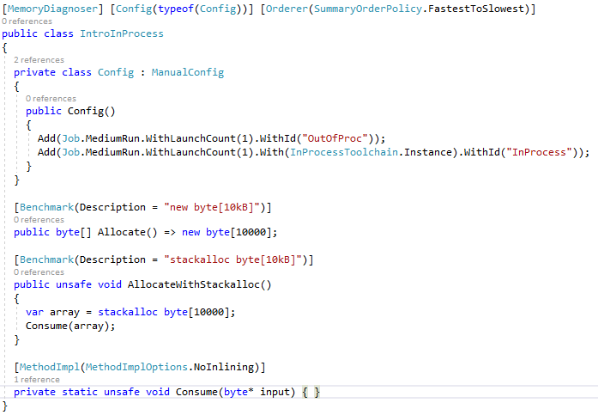
Memory diagnostics

Slide 25
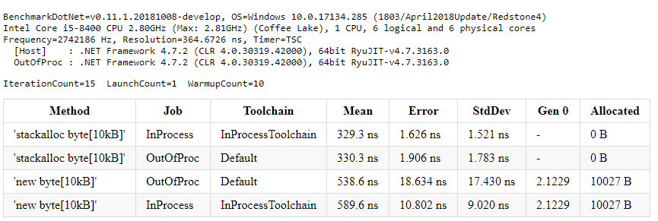
Memory diagnostics - Results

Slide 26
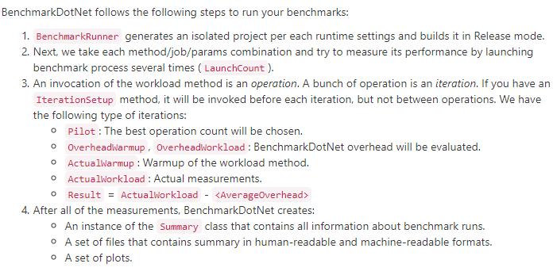
Benchmarking routine

Slide 27
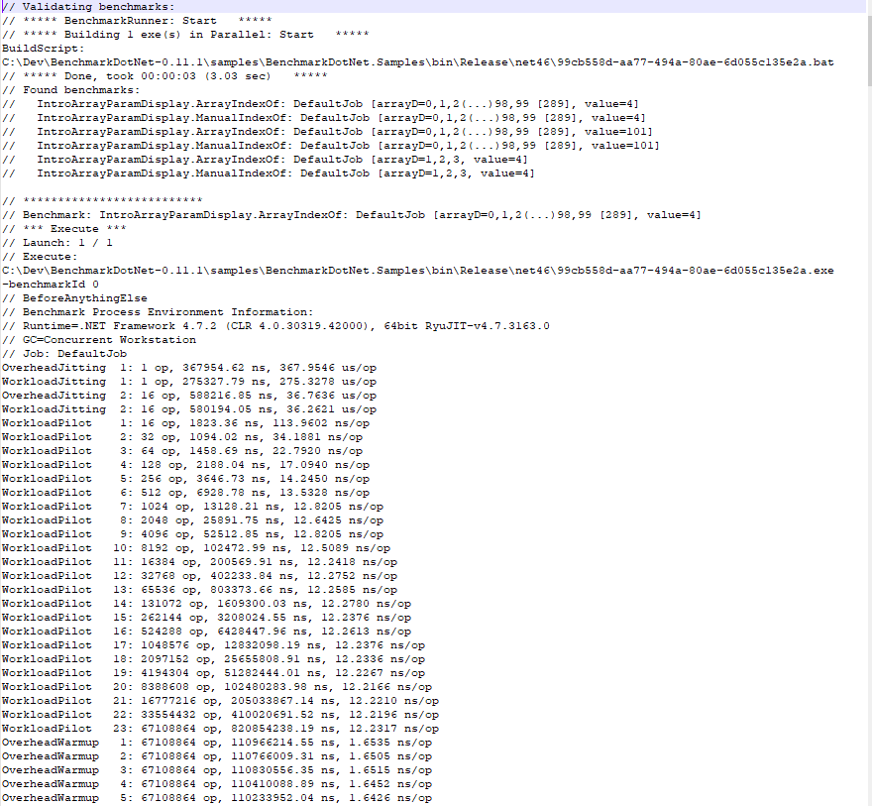
Benchmarking routine

Slide 28
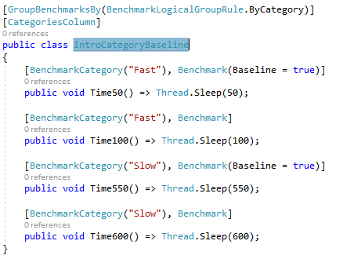
Relative performance

Slide 29
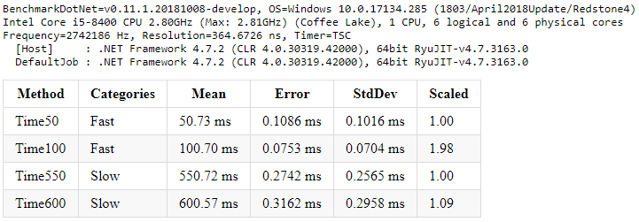
Relative performance

Slide 30
Demo

Slide 31
THANK YOU
Insert Image

